Slide 1
SAMR
Dr. Ruben Puentedura
Kathy Gust
ITC
Campbell & Henry Elementary

Slide 2
What is SAMR?
Model of technology integration
A framework to assist teachers in planning for instruction
4 areas describe role of tech in instruction
Substitution
Augmentation
Modification
Redefinition

Slide 3
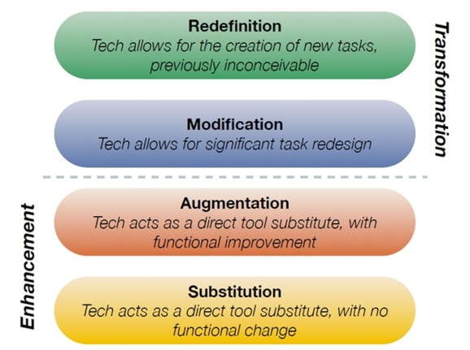

Slide 4
Successful Technology Integration
Teachers make purposeful decisions about technology based on impact of technology on student learning
Efficient use of digital tools
– appropriate technology
Design formative/summative assessment rubrics
Technology should improve the process or outcome
Technology should improve teaching and learning
Key is to connect tools and process with targeted level

Slide 5
Substitution Enhances Teaching and Learning
Trade old technology for new
Computer instead of typewriter
Read a book online
Research online
Watch videos online and take notes
All are good uses of technology for learning
Similar to Bloom’s lower levels
Remembering and understanding

Slide 6
Augmentation Enhances Teaching and Learning
Technology results in enhancement of
teaching and learning
Use spell check
Use templates to create brochures, cards, etc.
Contribute to online blogs
Some enhancement of teaching and learning is reached but…
Does not transform the process

Slide 7
Modification Transforms teaching and learning
Significant changes in how teachers and students work – independently or together
Email – communication and collaboration
Web 2.0 resources – online collaboration
GoogleDocs - use comments w/peers

Slide 8
Redefinition Transforms teaching and learning
Technology results in creation of new teaching and learning processes inconceivable before the technology
Collaborate globally
Wikis, video conferences
Create, post and share multimedia products
Flipped lessons
The world is your audience – schools without walls

Slide 9
Questions to Ask
S
A
M
R
What will I gain by replacing the task with new technology?
Does the technology add new features that improves the task?
Does the task significantly change with the use of technology?
Does the technology allow for creation of new tasks previously inconceivable?

Slide 10
Remember to: Focus on the Task
Focus is on the task – not the individual
Decide what to accomplish –
Then select the tool
True redefinition takes place when the focus is on the result, the content, NOT the app or software program.
The end result matters…Not the tool!

Slide 11
SAMR Math Lessons
Anne
Redefinition with Educreations

Slide 12
Concept by Tim Holt

Slide 13
SAMR Lessons
https://docs.google.com/a/apsva.us/document/d/1rDqVO1fnvO5BHV-La-PKONvzrEfsCJzrFij03YSzmuM/edit?usp=sharing

Slide 14
References
http://www5.bluevalleyk12.org/techsource/?p=1757
http://www.principals.org/tabid/3788/default.aspx?topic=Technology_Integration_Will_We_Know_It_When_We_See_It_A_New_Taxonomy
http://gettingsmart.com/2013/07/using-samr-to-teach-above-the-line/
https://historytech.wordpress.com/2012/11/26/the-samr-model-of-tech-integration-and-mobile-apps/
http://itunesu.bluevalleyk12.org/samr/samr_instructionaldecisions.pdf
https://www.edsurge.com/n/2015-02-06-a-guide-for-bringing-the-samr-model-to-ipads
https://jorganiser.files.wordpress.com/2013/08/samr-starbucks.jpg

